Slide 1
UW Dashboard Project
Group Name: NMA
Group Members:
Nihel Charfi
Mi --
Atlas --

Slide 2
Introduction:
Stakeholder: The dean of the engineering departments.
Role: plays a central role in the university’s academic administration as the administrative head and academic leader of the departments, by supporting and raising the highest quality educational programs, plans and directs department activities related to student services and campus life.
KPI’s:
Classroom utilization rate
Percentage of enrollment
Course trend

Slide 3
1. KPI: Classroom utilization rate
Goal: Checks whether the dean is making the best use of the campus space.
Measure:
Classroom availability: Monday through Saturday between 7:00 a.m. and 11:00 p.m
Time utilization goal is 71%
Objectives:
Calculate the percentage scheduled for each room daily for Fall 2017.
Comparing the top 5 classrooms utilization daily for all terms.
Identify the top engineering department of highest classrooms utilization.

Slide 4
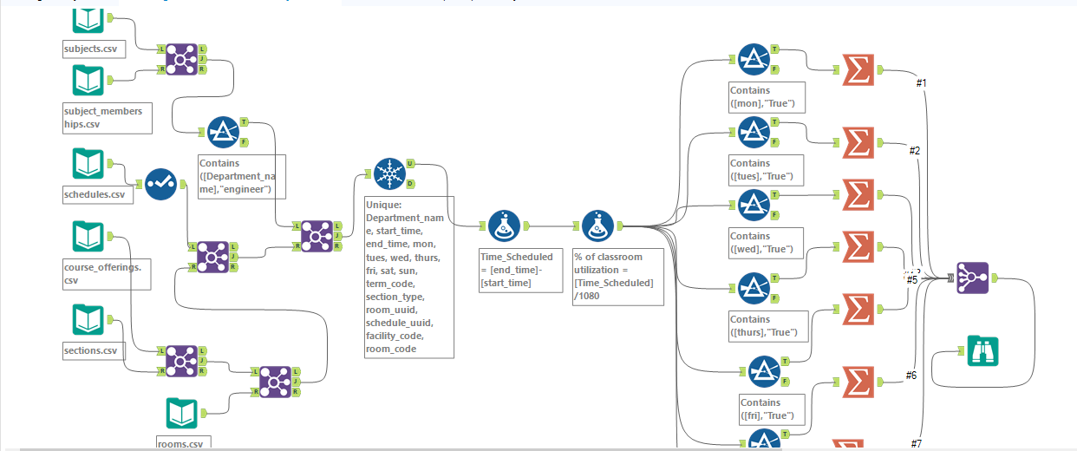
Alteryx Layout
subject and subject_membership to filter engineering department, schedule to calculate the percentage of classrooms utilization (total time scheduled /the total time was available) then join all together with course_offering for terms with sections and rooms to select the room. code.

Slide 5
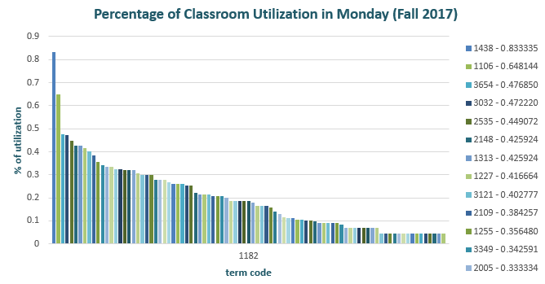
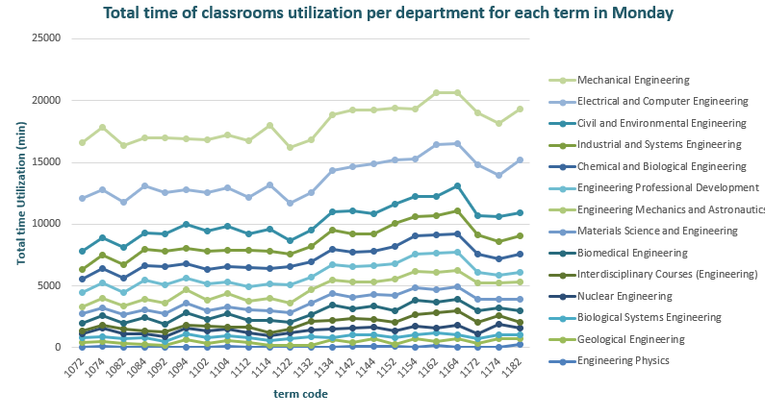
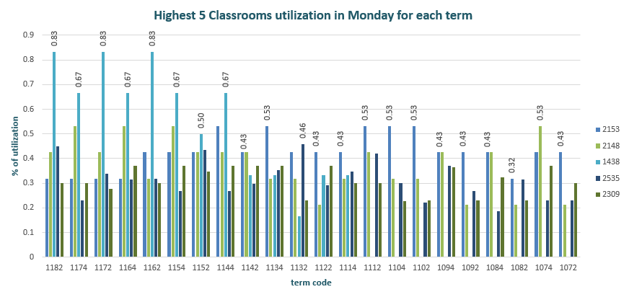
Monday Classroom utilization
Room No 1438 was overscheduled in Fall 2017 of 83%.
Percentage of utilization in latest Fall terms (Fall 2015, 2016 and Fall 2017) is higher than the others of 83% for the room no 1438.
Total classrooms utilization in mechanical engineering is very high compared to engineering physics especially in Fall 2015 and spring 2016.
CXXDDD

Slide 6
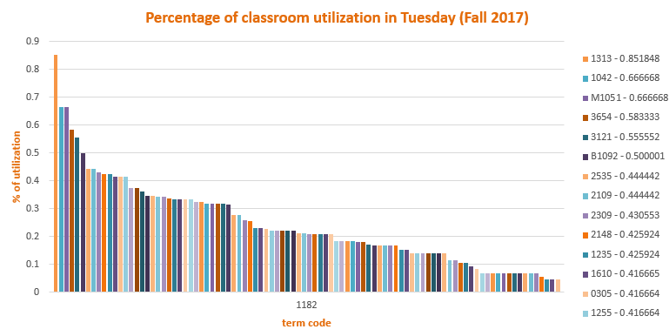
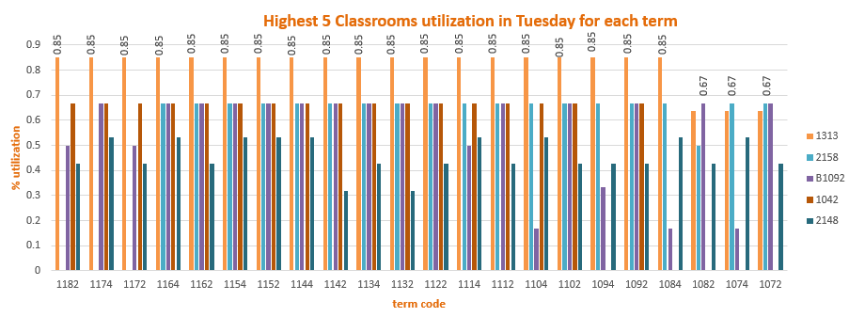
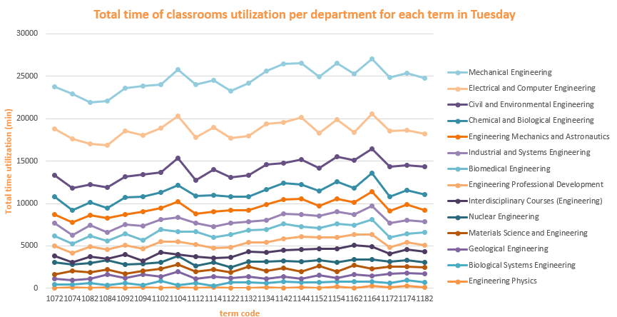
Tuesday Classroom utilization
Room No 1313 was overscheduled in Fall 2017 of 85%.
Percentage of utilization of room No 1313 is very high from Fall 2008 to Fall 2017.
Mechanical engineering still has the highest utilization specifically in Spring 2016.

Slide 7
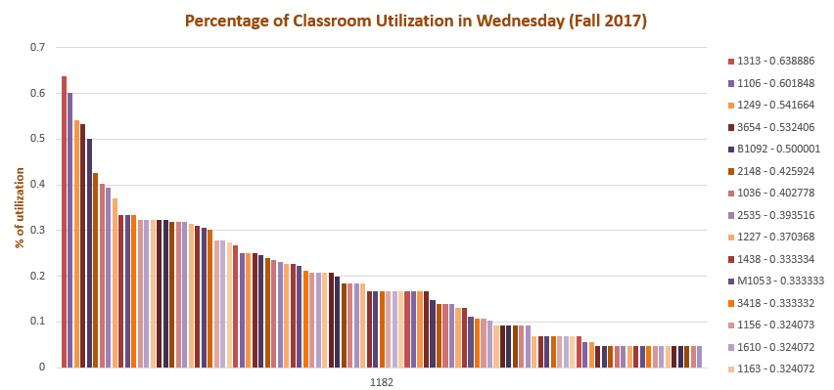
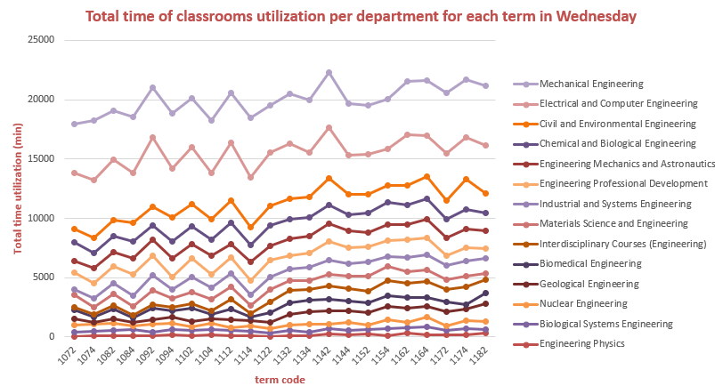
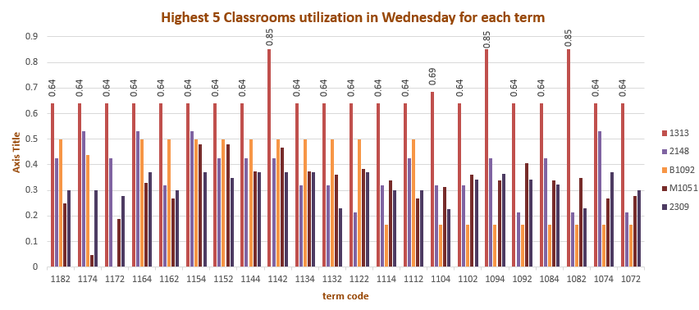
Wednesday Classroom utilization
No overscheduling in Wednesday for Fall 2017, the highest % is 63 for Room 1313.
Percentage of utilization of room No 1313 is very high 85% for the terms 1082,1094 and 1142.
Mechanical engineering is high in Fall 2013 for classrooms utilization and comparing to other departments.
Öykü Gürman

Slide 8
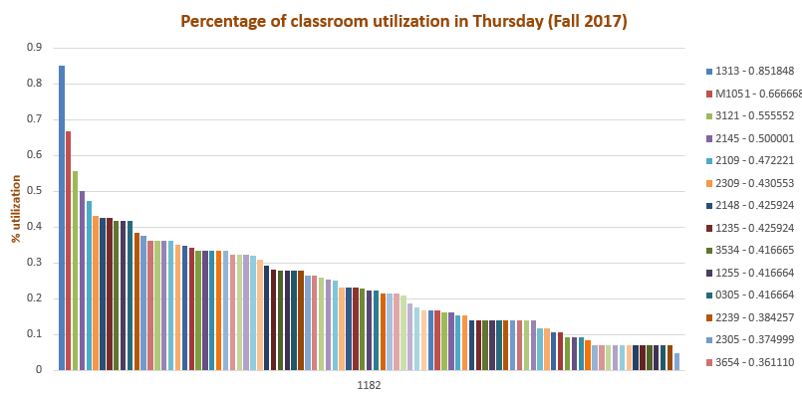
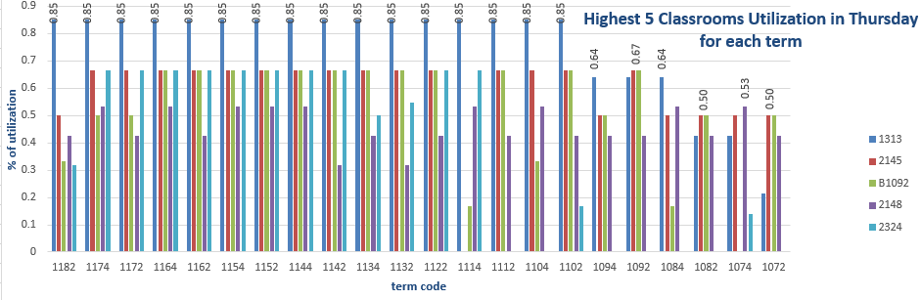
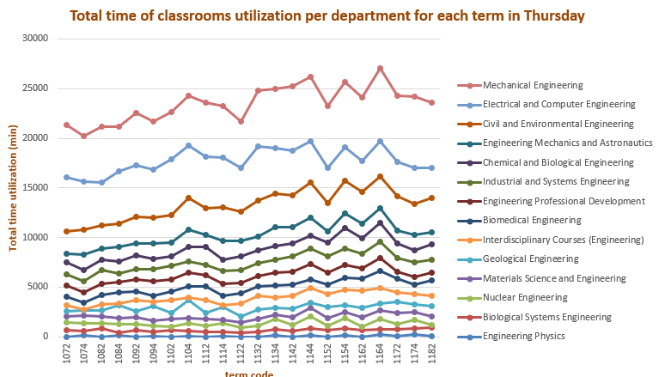
Thursday Classroom utilization
Overscheduling in Thursday for Fall 2017, the highest % is 85 for Room 1313.
Percentage of utilization of room No 1313 is very high 85% for Fall 2009 to Fall 2017.
Mechanical engineering is higher than other departments especially the total utilization in Spring 2016.

Slide 9
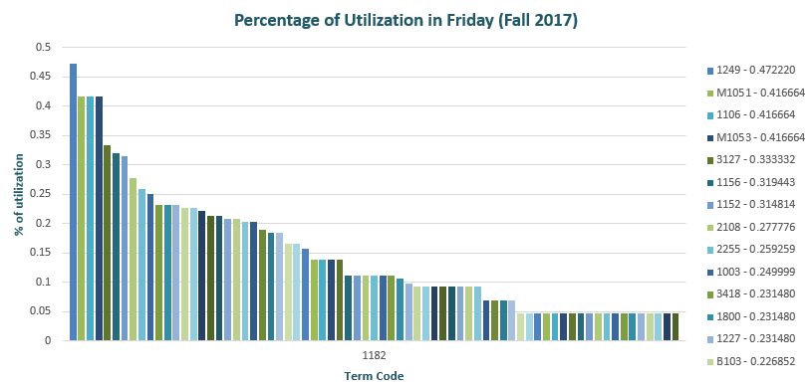
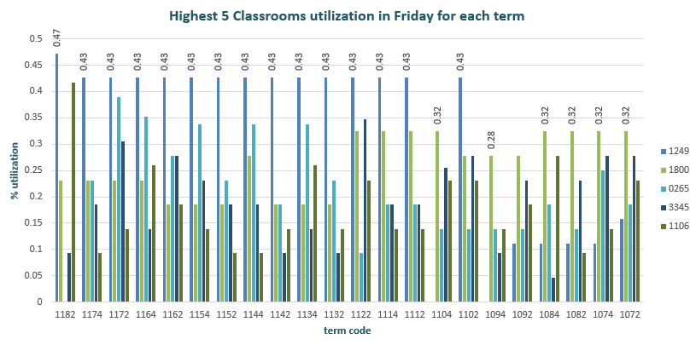
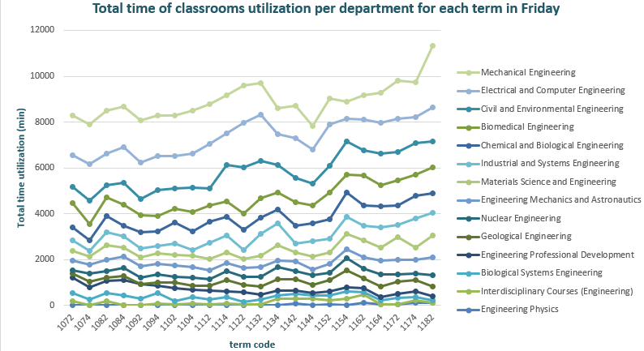
Friday Classroom utilization
No overscheduling in Wednesday for Fall 2017, the highest % is 47 for Room 1249.
Rooms 1249, 1800, 0265, 3345 and 1106 are the 5 tops classrooms utilization for all terms but they are no overscheduling.
Mechanical engineering has the highest utilization in Fall 2017 and comparing to other engineering departments.

Slide 10
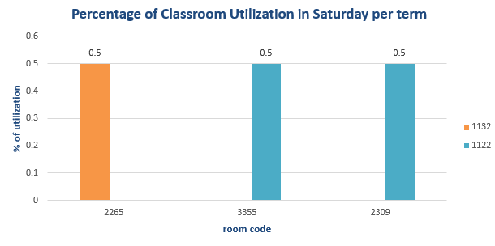
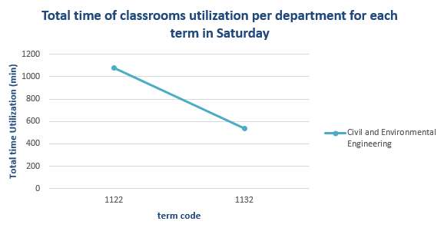
Saturday Classroom utilization
Only two terms Fall 2011 and Fall 2012 have a scheduled classrooms of 50% of time utilization for the rooms no 2265, 3355 and 2309.
Those scheduled classrooms are in Civil and Environmental Engineering for both terms.

Slide 11
2. KPI: Percentage of enrollment
Percentage of enrollment in different subjects: allows the dean to know the enrollment per subject in each term, and compare them to different terms.
Measure:
1. Ranking the percentage of enrollment each subject in every term.
2. Compare these percentage in every academic year.
3. Compare these percentage year by year.

Slide 12
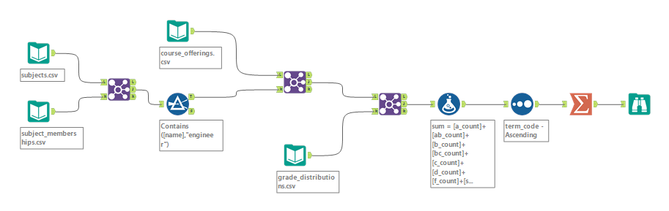
Sources & Alteryx Layout
Firstly, we can get the subject names by joining the table ‘subject’ and ‘subject_membership’, then filter out all the engineering departments. Secondly, combine it with ‘courses_offering’ and ‘grade_distribution’ to get the total enrollment of each department and each term.

Slide 13
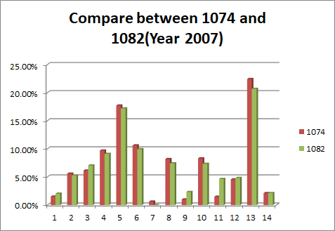
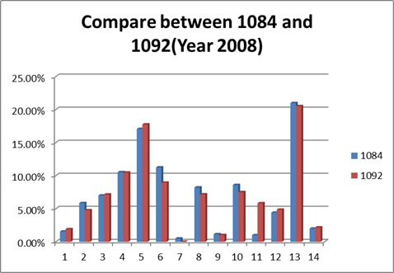
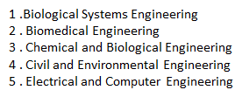
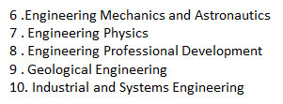
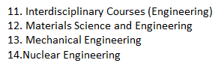
Graph
To show students' interests in different fields term by term.

Slide 14
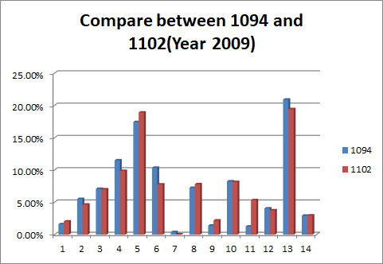
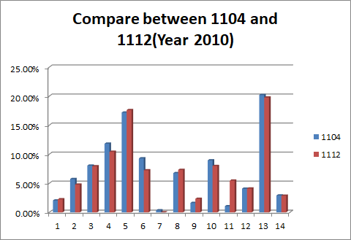
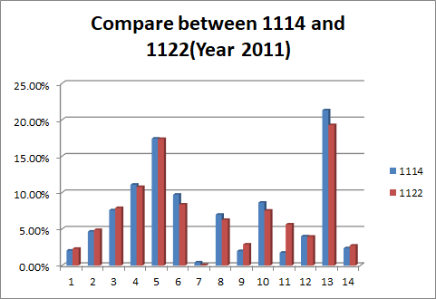
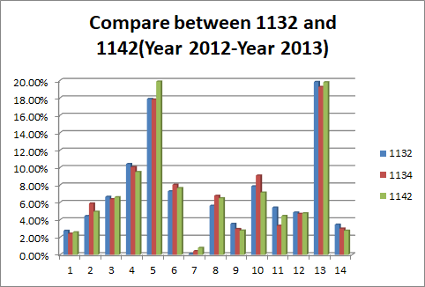
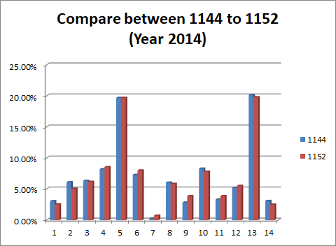
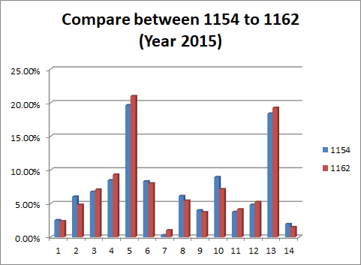
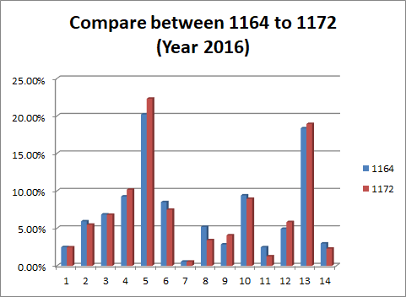
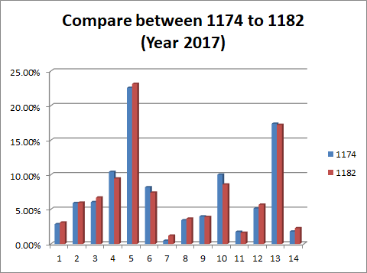

Slide 15
3. KPI: Class Trend
Course trend: helps the dean to know the popular courses in the engineering departments.
Measure:
1. Ranking the total enrollment number of each class to identify the popular courses;
2. Compare Top 10 classes year by year(term).
3. Compare Top1 course from 2006-2017(term).

Slide 16
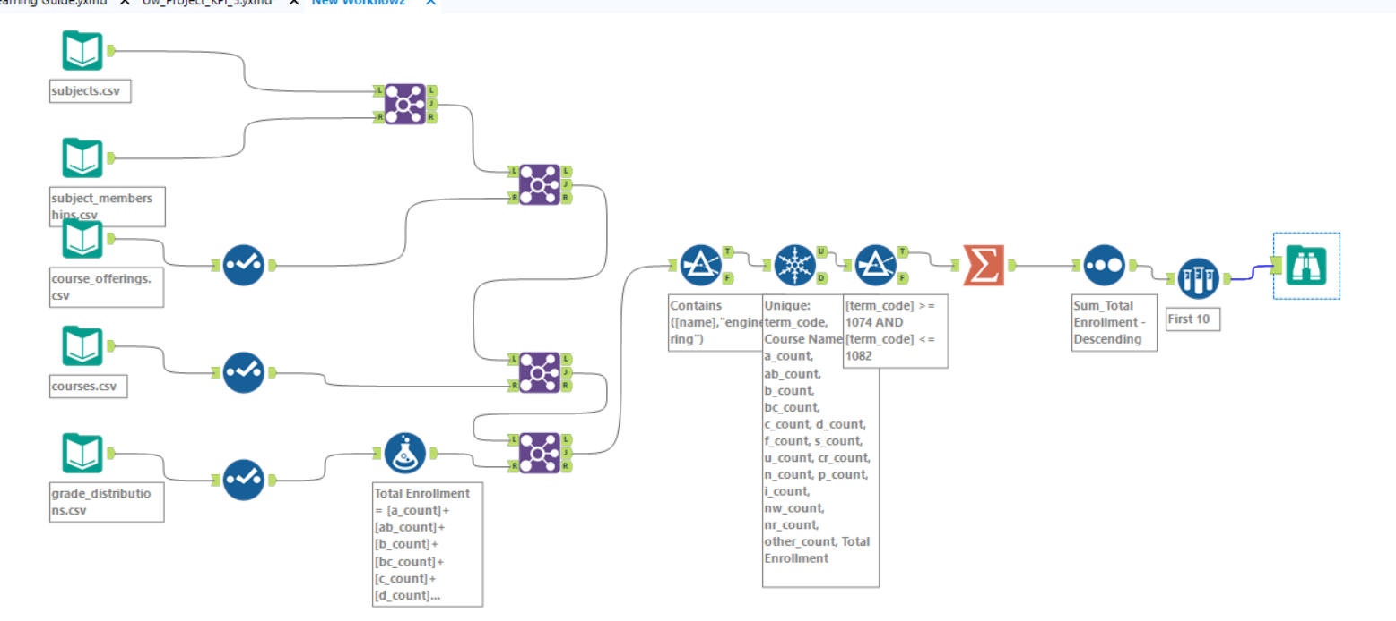
Alteryx Layout
Data source: Subject(Department info), Course(Course info), Grade_distribution(Enrollment number ), filter(Engineering)

Slide 17
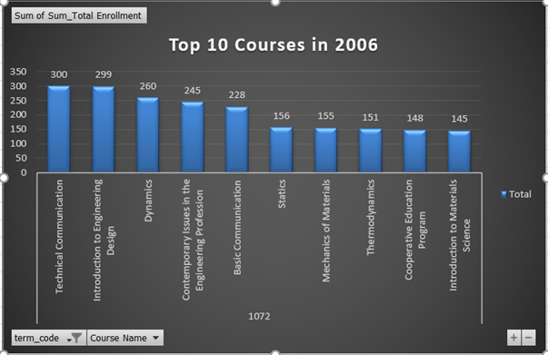
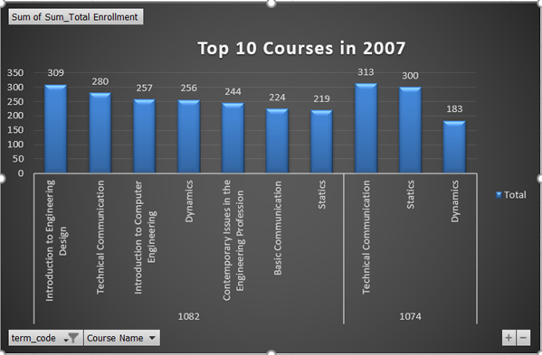
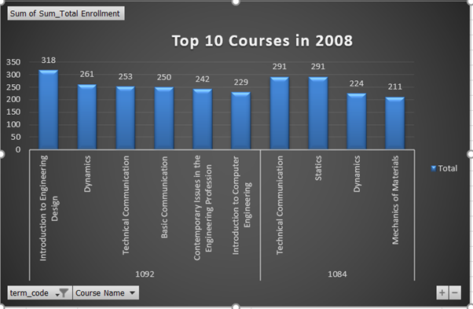
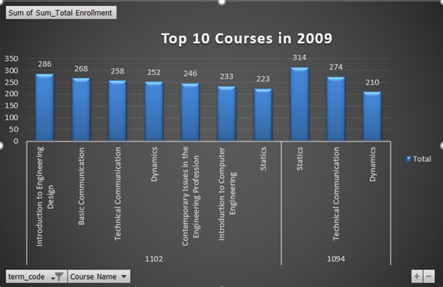
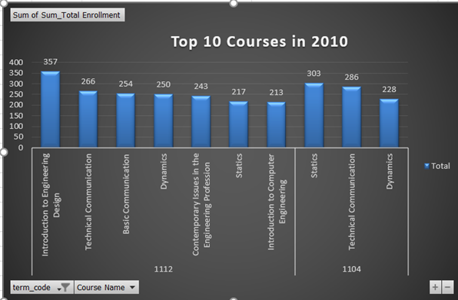
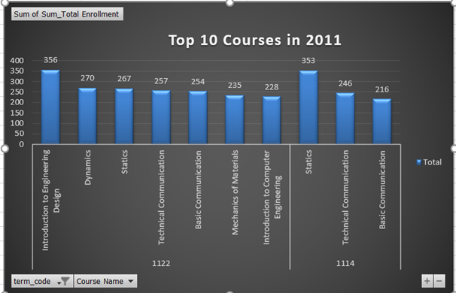
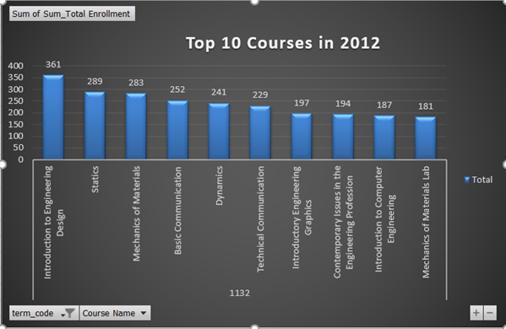
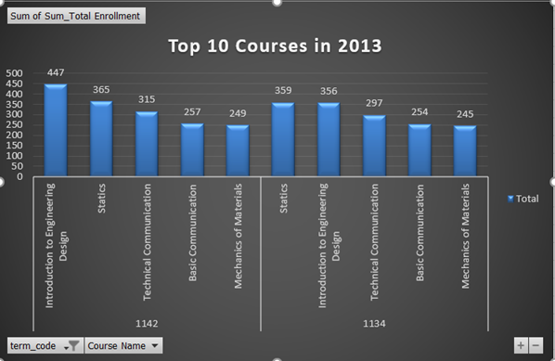
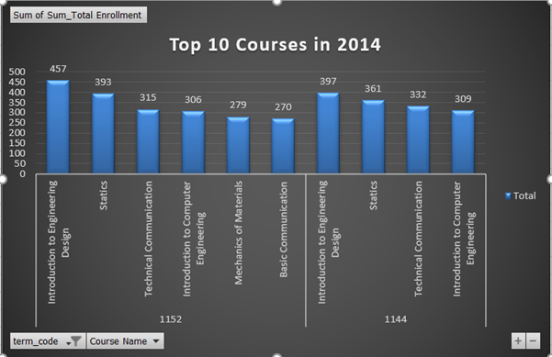
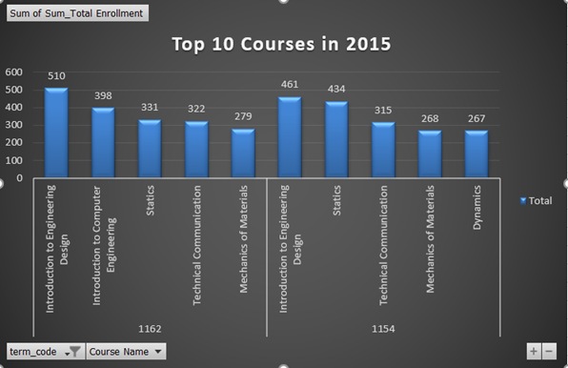
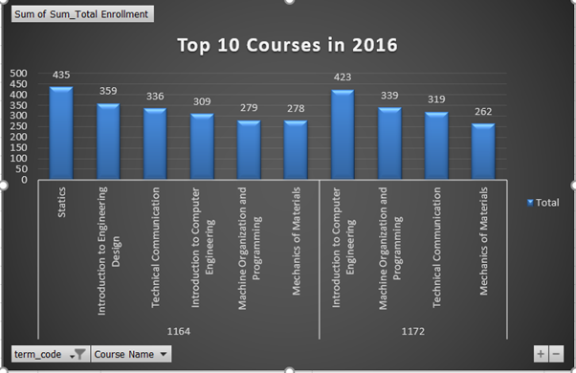
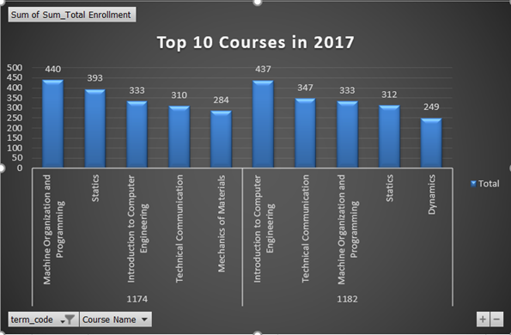

Slide 18
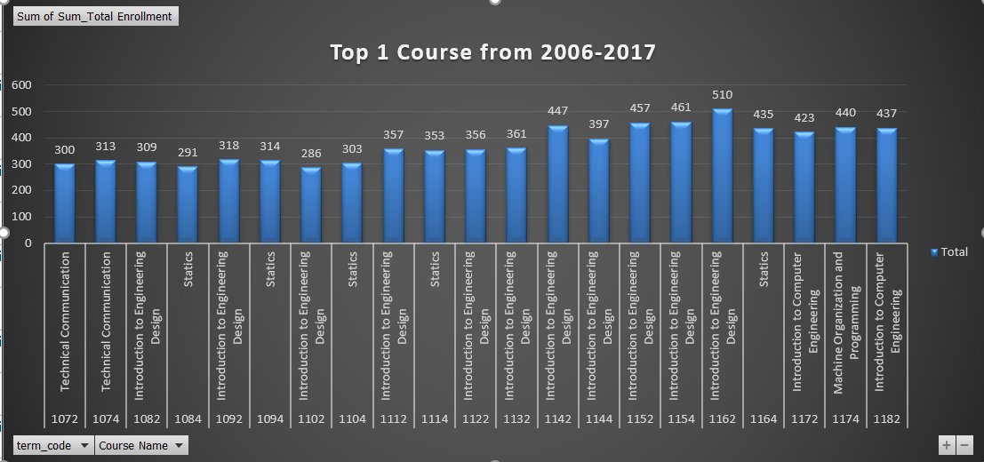
Top 1 Course from 2006-2017

Slide 19
Consulsion
1. Classroom utilization rate
•Room 1313 was overscheduled in Tuesday from Spring 2008 to Fall 2017 and in Thursday from Fall 2009 to Fall 2017 of 85%.
•Room 1438 was overscheduled in Monday for Fall 2015 , 2016 and 2017 of 83%.
•Mechanical engineering department has the highest classroom time utilization for all terms and days.
2. Percentage of enrollment
•Over a half students are interested in the fields of Civil and Environmental Engineering, Mechanical Engineering, and Electrical and Computer Engineering. Very few students enrolled in Engineering Physics.
•Before 2012, more students were interested in Mechanical Engineering, but after 2013, students switch their interest to Electrical and Computer Engineering.
3. Course Trend
•Introduction to Engineering Design is the trending course from 2006 to 2017.
•The total number of enrollment has increased in Engineering departments from 2006 to 2017.

